Slide 1
Introduction to Programming in Python
Ezekiel Adebayo Ogundepo (@gbganalyst)

Slide 2
Write your own function

Slide 3
Python functions
Python function extends the functionality of Python. It is a block of organized and reusable code that is used to perform a single and related action. It is a piece of code that runs when it is called or referenced. Python provides many inbuilt functions like print(), input(), type(), len(), etc. but it also gives freedom to create your own functions.

Slide 4
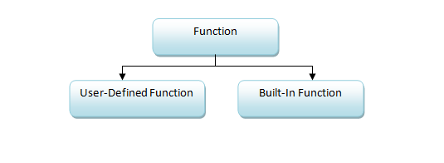
Type of Function
Basically, we can categorize functions into the following two types:
Built-in functions - Functions that are pre-defined in Python
User-defined functions - Functions defined by the users themselves

Slide 5
Advantages of Python Functions
Function allows us to automate repetitive tasks in a more powerful way than copy-and-pasting. Writing a function has the following advantages:
You can give a function a name that makes your code easier to understand and remember.
As something changes, you only need to update code in one place, instead of many places.
it avoids repetition and makes the code reusable.
Improves maintainability of the code.

Slide 6
When should you write a function?
You should consider writing a function whenever you have copied and pasted a block of code more than twice.

Slide 7
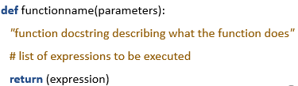
User-defined function syntax in Python

Slide 8
Rules in creating a function
Creating a function follows the following rules:
Function blocks begin with the keyword def followed by the function_name, parentheses ( ), a colon (:), and is indented. Function name follows the same rules of naming variables in Python.
Any parameters or arguments should be placed within these parentheses. You can add as many arguments as you want, just separate them with a comma. Parameters (arguments) helps to pass values to a function. They may be optional sometimes.
A colon (:) to mark the end of the function header.
Optional documentation string (docstring) to describe what the function does (for documentation purposes).
One or more valid python statements that make up the function body. Statements must have the same indentation level (Jupyter lab/notebook does this for you when you press return button after the colon mark).
Functions may return a value to the caller, using return statement. This is optional.

Slide 9
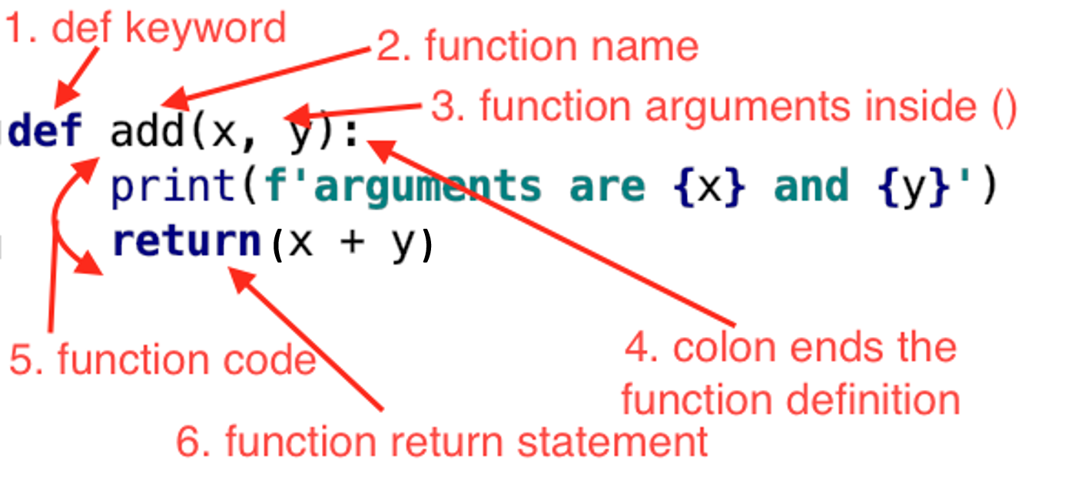
Addition of two numbers

Slide 10

Lab session

